Slide 1
Intro to Data Vis for Learning Analytics Video A: Introduction to Data Vis in Learning Analytics
Dr. Jaclyn Ocumpaugh, Associate Director, Penn Center for Learning Analytics

Slide 2
Video A: Introduction to Data Visualization in Learning Analytics
Objective: What we will cover in this section and what resources are available
Who needs data visualizations?
What do we need to know to make effective data visualizations?
What’s in our Additional Resources page?
What will we cover in this section of the course?

Slide 3
Dashboards are emerging as a new area in LA
Early work sometimes naïve
how much data literacy the audience has
how data visualization would affect motivation and behavior of the audience

Slide 4
Dashboard Types in Learning Analytics
By Audience
By Features, Data Organization, Content
For admin
For teachers
For students
For parents
For guidance counselors
For other stakeholders
Interactive vs. Not
Learning Analytics vs. Academic Analytics
Descriptive, Predictive, and/or Prescriptive
e.g., Early Warning Systems (EWS)
Individual vs. Course (for teachers)
Individual vs. Collaborative (students)

Slide 5
Dashboard Types in Learning Analytics
By Audience
By Features, Data Organization, Content
For admin
For teachers
For students
For parents
For guidance counselors
For other stakeholders
Interactive vs. Not
Learning Analytics vs. Academic Analytics
Descriptive, Predictive, and/or Prescriptive
e.g., Early Warning Systems (EWS)
Individual vs. Course (for teachers)
Individual vs. Collaborative (students)

Slide 6
Good Dashboards Required a Multidisciplinary Approach
Statistics/Algorithmic Bias/Fairness
Human Computer Interaction (HCI)
Data Visualization/Number Perception
Statistical Literacy/Number Sense/Data Literacy
Psychology of Learning
Universal Design/Learning Disabilities and Neurodivergence/Other Accessibility Issues (e.g., color-blindness, etc.)
Motivation/Interest/Self-Regulated Learning (SRL)
Domain Knowledge
Cultural Differences in Human-to-Human and Human Computer Interaction (HCI)
No need to memorize this list!

Slide 8
Actionable Insights

Slide 9
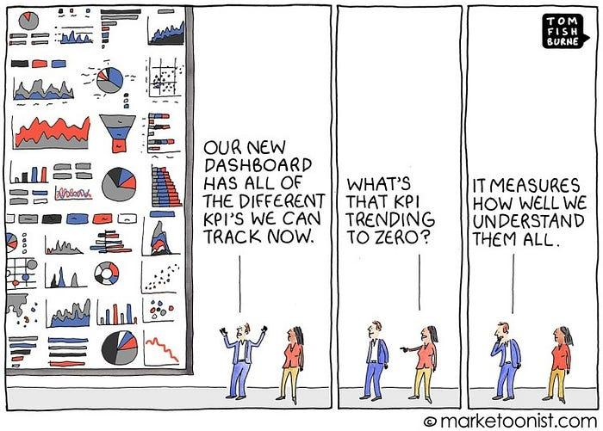
Image Credit: https://marketoonist.com/2019/11/kpi-overload.html

Slide 10
Additional Resources Page

Slide 11
These videos
Video A: Introduction to Data Visualization in Learning Analytics
Video B: Who is our Audience?
Video C: Visualization Sciences
Video D: Example Dashboard (1st Draft)
Video E: Visualization Sciences & Cognitive Biases
Video F: Example Dashboard (2nd Draft)
Video G: Types of Data and Dashboards
Video H: Theory & Data Vis in Learning Analytics
Video I: Story Telling with our Example Dashboard
Video J: The Future of Dashboards

Slide 12
Intro to Data Vis for Learning Analytics Video B: Who is our Audience
Dr. Jaclyn Ocumpaugh, Associate Director, Penn Center for Learning Analytics

Slide 13
Video B: Who is our Audience?
Objective: Who are we designing for and what are their needs and agency?
Who do we design for?
Researchers, stakeholders
What data literacy skills might they have?
Examples from learners, teachers, researchers, doctors
What other considerations do we need to account for?
Agency
Actionability, Learning Theories, & Motivational Theories
Timing
Examples
What is actionable in this dashboard?

Slide 14
Dashboards for WHOM?
Visualizations for discovery (e.g., RESEARCHERS)
Visualizations for learning applications (e.g., EVERYONE ELSE)
TEACHERS
LEARNERS
PARENTS
PRINCIPALS
GUIDANCE COUNESELOS
SUPERINTENDENTS
OTHER ADMINISTRATORS/STAKEHOLDERS

Slide 15
Know your audience – Data Literacy
Students
Teachers
Researchers
Others (doctors)
Things might be better in other countries, but in the US, we have a problem with data literacy.
We must keep data literacy in mind as we design our visualizations.

Slide 16
Students & Probability
Suppose you are playing a carnival game that involves flipping two balanced coins simultaneously. To win the game you must obtain "heads" on both coins. What is your probability of winning the game?
Approximately 50% of the 12th grade students in the study believed that there is a 50% chance of winning the game.
Zawojewski, J. S., & Shaughnessy, J. M. (2000). Data and chance. In E. A. Silver & P. A. Kenney (Eds.), Results from the Seventh Assessment of Educational Progress (pp. 235-268). Reston: VA: National Council of Teachers of Mathematics.

Slide 17
Licensable

Slide 18
“75.6% of teachers’ estimations for addition were in a reasonable range, whereas this rate was only 54.1% for their estimations of division for the same fraction pairs… 14.5% did not provide a reasonable estimation for either operation
Copur-Gencturk, Y. (2022). Teachers’ knowledge of fraction magnitude. International Journal of Science and Mathematics Education, 20(5), 1021-1036.

Slide 19
300 Math Teachers in your School District
“As shown in Fig. 2, 45% of the sample provided a reasonable estimation for both operations, whereas 14.5% did not provide a reasonable estimation for either operation.”

Slide 20
Ten Math Teachers in your School/Small Town

Slide 21
Researchers’ Ability to Estimate Problems with Fractions
Three researchers in a pilot study coded the phenomenon as either present (Y), absent (N), or ambiguous (?). The resulting data showed 60% of codes were in full (3/3) or partial (2/3) agreement.
A senior researcher in the field thought this level agreement was good because 60% > 50%.
Ocumpaugh, personal experience.

Slide 22
Y
Y
Y
?
?
N
Y
?
?
27 rows
N
N
N
?
N
N
?
Y
?
Y
Y
N
N
?
?
Y
?
Y
Y
N
N
N
N
?
N
?
Y
N
Y
Y
?
N
?
?
Y
N
N
N
Y
N
?
N
Y
N
?
N
Y
N
?
?
Y
N
Y
?
Y
N
Y
?
Y
Y
?
N
Y
?
?
?
Y
Y
?
Y
?
N

Slide 23
Y
Y
Y
?
?
N
Y
?
?
27 rows
3 w/complete agreement = 3/27 or 11.1%
18 with 2/3 agreement = 18/27 or 70%
N
N
N
?
N
N
?
Y
?
Y
Y
N
N
?
?
Y
?
Y
Y
N
N
N
N
?
N
?
Y
N
Y
Y
?
N
?
?
Y
N
N
N
Y
N
?
N
Y
N
?
N
Y
N
?
?
Y
N
Y
?
Y
N
Y
?
Y
Y
?
N
Y
?
?
?
Y
Y
?
Y
?
N

Slide 24
Y
Y
Y
?
?
N
Y
?
?
27 rows
3 w/complete agreement = 3/27 or 11.1%
18 with 2/3 agreement = 18/27 or 70%
6 w/no agreement = 6/27 or 22.2%
N
N
N
?
N
N
?
Y
?
Y
Y
N
N
?
?
Y
?
Y
Y
N
N
N
N
?
N
?
Y
N
Y
Y
?
N
?
?
Y
N
N
N
Y
N
?
N
Y
N
?
N
Y
N
?
?
Y
N
Y
?
Flawed interpretation:
60% with either 2/3 or 3/3 is “good” because it’s “better than 50%”
Base rate for that is 87.5%
Y
N
Y
?
Y
Y
?
N
Y
?
?
?
Y
Y
?
Y
?
N

Slide 25
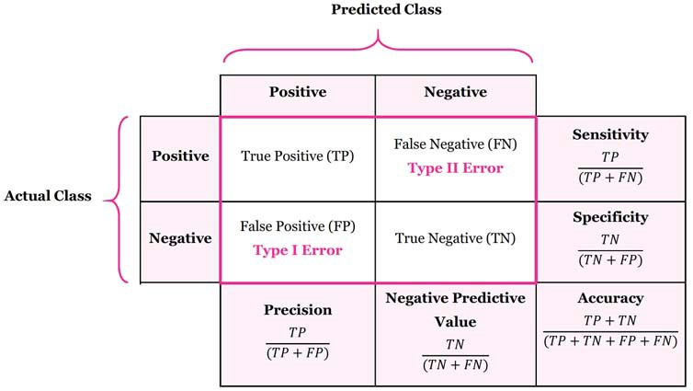
Gigerenzer et al., (2007) Statistical Literacy, practicing OB/GYNS
Gave 160 practicing OB/GYNS the following info:
“Assume you conduct breast cancer screening using mammography in a certain region. You know the following information about the women in this region:
The probability that a woman has breast cancer is 1% (prevalence)
If a woman has breast cancer, the probability that she tests positive is 90% (sensitivity)
If a woman does not have breast cancer, the probability that she nevertheless tests positive is 9% (specificity)”
90%
9%
Image Credit: https://stats.stackexchange.com/questions/122225/what-is-the-best-way-to-remember-the-difference-between-sensitivity-specificity
Gigerenzer, G., Gaissmaier, W., Kurz-Milcke, E., Schwartz, L. M., & Woloshin, S. (2007). Helping doctors and patients make sense of health statistics. Psychological science in the public interest, 8(2), 53-96.

Slide 26
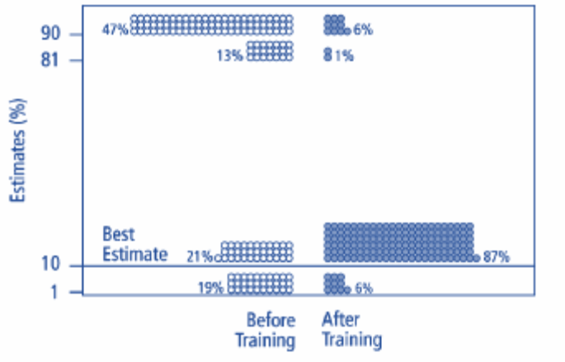
“A woman tests positive. She wants to know from you whether that means that she has breast cancer for sure, or what the chances are. What is the best answer?
The probability that she has breast cancer is about 81%.
Out of 10 women with a positive mammogram, about 9 have breast cancer
Out of 10 women with a positive mammogram, about 1 has breast cancer.
The probability that she has breast cancer is about 1%.”
Assessing Doctors’ Understanding of Prevalence Effects
Prevalence = 1%
Sensitivity (true positives) = 90%
False-positive rate = 9%
47% of doctors
13% of doctors
21% of doctors
19% of doctors
Gigerenzer, G., Gaissmaier, W., Kurz-Milcke, E., Schwartz, L. M., & Woloshin, S. (2007). Helping doctors and patients make sense of health statistics. Psychological science in the public interest, 8(2), 53-96.

Slide 27
Training Doctors on Prevalence
“Assume you conduct breast cancer screening using mammography in a certain region. You know the following information about the women in this region:
Ten out of every 1,000 women have breast cancer
Of these 10 women with breast cancer, 9 test positive
Of the 990 women without cancer, about 89 nevertheless test positive”
Gigerenzer, G., Gaissmaier, W., Kurz-Milcke, E., Schwartz, L. M., & Woloshin, S. (2007). Helping doctors and patients make sense of health statistics. Psychological science in the public interest, 8(2), 53-96.

Slide 28
Know your audience – Agency
Students
Teachers
Researchers
Others (doctors)
Agency: ability to act to effect change

Slide 29
Agency: What can I control?
Tl;dr: me, mostly

Slide 30
Agency: What can I control in my class?
…as an able-bodied, middle-class student
Directly
Indirectly
Not really
Setting Goals
What readings and assignments I do and how I approach them
Any additional effort I put in to learn more about the topic
How much effort I put into them
Reflecting on what is working/not; how I respond to feedback
How much I interact with the teacher and other students
Whether or not the teacher feels I am doing my work and reflecting on the feedback
How reasonable the course assignments are
Whether or not my teacher has reasonable work/life contexts
What feedback I get
What resources are available in my school
Whether or not my prior knowledge connects to course materials
How natural disasters interact with the semester

Slide 31
Agency: What can I control in my class?
…as a college professor
Directly
Indirectly
Not really
What readings and activities are assigned
How assignments are structured
When discussion is encouraged and whether I encourage students to connect to their own interest
What feedback I provide and how I react to student feedback
How I enforce consequences
How much outside reading I do to improve my own knowledge and understanding
Whether or not students feel the reading and assignments are important
Whether or not students feel safe getting and providing feedback
Whether or not they feel supported and/or understand the consequences of disengagement
Whether or not my students and I have shared background knowledge at the start of the semester
Whether or not students read and do the assignments
Whether or not they accept the feedback
Whether or not they think the consequences are reasonable
How natural disasters interact with the semester
Anything outside of my class

Slide 32
Agency: What can I control in a learning system?
…as a data vis researcher
Directly (sometimes)
Indirectly
Not really
What is in the learning system (sometimes)
Whether the data we display to teachers and students is related to things they have control over (sometimes)
Whether we display it in ways that align with motivational theories
Whether the data is displayed in a way that can encourage improved data literacy
Whether teachers feel like the
The data literacy, prior knowledge, motivation, etc. of the students and teachers we are designing for.
Whether the data is used for good or for evil
Most things happening in the classroom or the world

Slide 33
What does this mean in for data vis design in learning analytics?
If a student sees that they have done poorly, will they know what to do to get better?
If a teacher sees that a student is doing poorly, what will they do with that information?

Slide 34
To summarize
We need to be careful that our data vis is targeted at the data literacy of our audience. Research among people with strong STEM training in the US suggests that even people with a lot of education struggle with statistical interpretation.
We also need to pick data that is ACTIONABLE. To do that, we need to understand what AGENCY our audience has over the learning experience.

Slide 35
Intro to Data Vis for Learning Analytics Video C: Example Dashboard (1st Draft)
Dr. Jaclyn Ocumpaugh, Associate Director, Penn Center for Learning Analytics

Slide 36
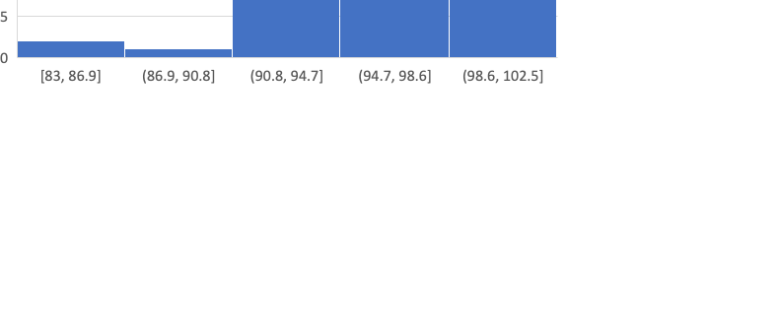
Professor Q’s Organic Chemistry
Big State University, Spring 2024
Jan 30, 2024

Slide 37
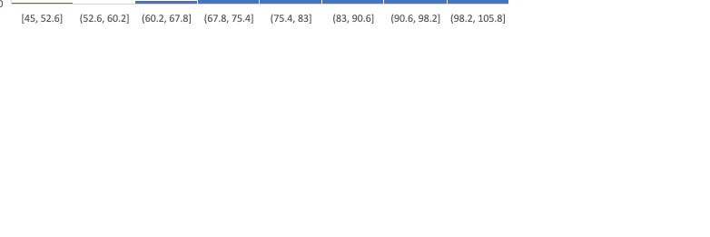
Professor Q’s Organic Chemistry
Big State University
Feb 20, 2024

Slide 38
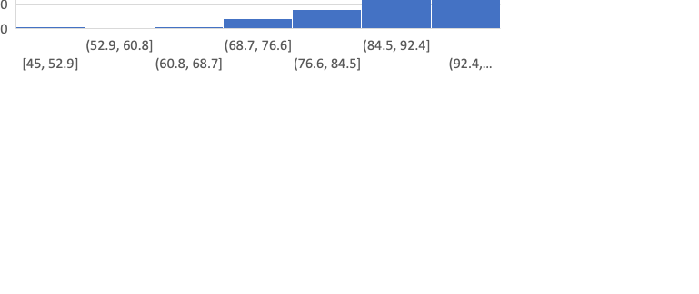
Professor Q’s Organic Chemistry
Big State University
March 1, 2024

Slide 39
Based on what you’ve seen
Which students are struggling?

Slide 40
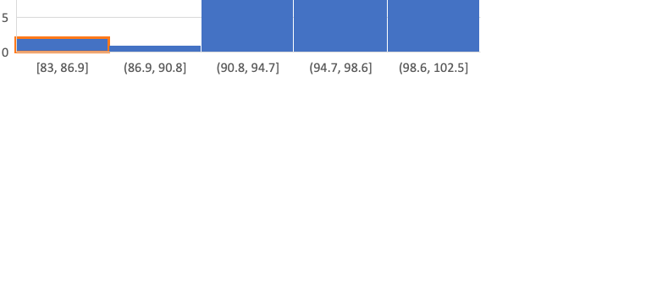
Professor Q’s Organic Chemistry
Big State University, Spring 2024
Jan 30, 2024

Slide 41
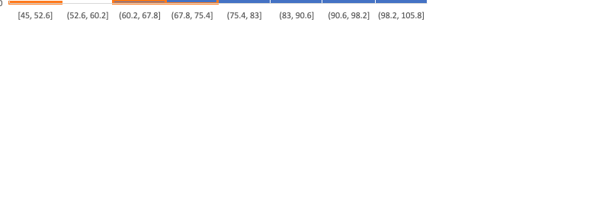
Professor Q’s Organic Chemistry
Big State University
Feb 20, 2024

Slide 42
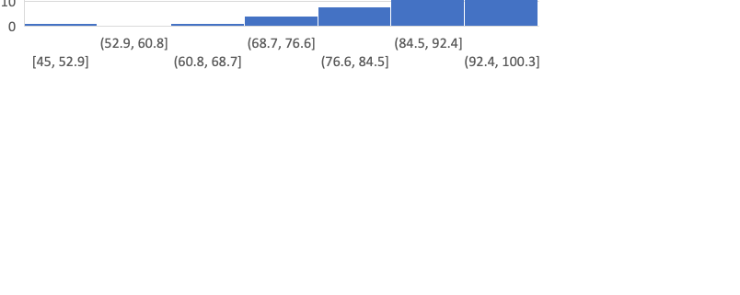
Professor Q’s Organic Chemistry
Big State University
March 1, 2024

Slide 43
Based on what you’ve seen
 | student 17 | student 21
Quiz 1 | 95 | 85
Quis 2 | 93 | 83
Quiz 3 | 45 | 62
Quiz 4 | 91 | 63
Quiz 5 | 85 | 78
Quiz 6 | 93 | 65
Quiz 7 | 84 | 71
What quizzes are students struggling on?
Quiz 3 and quiz 8 are the lowest
Which students are struggling? (If struggling is <70)
Student 21
Student 17
What should we make them do?
This dashboard doesn’t tell us

Slide 44
Intro to Data Vis for Learning Analytics Video D: Visualization Sciences & Cognitive Biases
Dr. Jaclyn Ocumpaugh, Associate Director, Penn Center for Learning Analytics

Slide 45
Video D: Visualization Sciences
Objective: Explore various types of data visualizations applicable to learning analytics scenarios.
Data Vis and Visualization Sciences–a shift in the field that Learning Analytics should follow
Cognitive Biases
What biases affect even people with high data literacy?
Other biases?
Examples
What is actionable and reasonable in this dashboard?

Slide 46
Overviews on Dashboard Research
Vieira, C., Parsons, P., & Byrd, V. (2018). Visual learning analytics of educational data: A systematic literature review and research agenda. Computers & Education, 122, 119-135.
Valle, N., Antonenko, P., Dawson, K., & Huggins‐Manley, A. C. (2021). Staying on target: A systematic literature review on learner‐facing learning analytics dashboards. British Journal of Educational Technology, 52(4), 1724-1748.
Bodily, R., & Verbert, K. (2017). Review of research on student-facing learning analytics dashboards and educational recommender systems. IEEE Transactions on Learning Technologies, 10(4), 405–418.
Verbert, K., Ochoa, X., De Croon, R., Dourado, R. A., & De Laet, T. (2020). Learning analytics dashboards: The past, the present and the future. Proceedings of the 10th International Conference on Learning Analytics & Knowledge (pp. 35-40).
Teasley, S. D., Kay, M., Elkins, S., & Hammond, J. (2021). User-centered design for a student-facing dashboard grounded in learning theory. Visualizations & Dashboards for Learning Analytics, 191-212.
Schwendimann, B. A., Rodriguez-Triana, M. J., Vozniuk, A., Prieto, L. P., Boroujeni, M. S., Holzer, A., ... & Dillenbourg, P. (2016). Perceiving learning at a glance: A systematic literature review of learning dashboard research. IEEE Transactions on Learning Technologies, 10(1), 30-41.

Slide 47
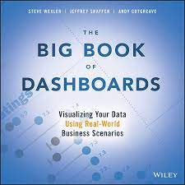
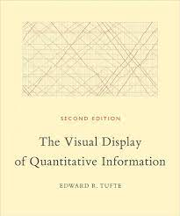
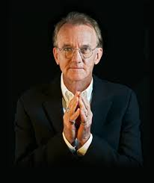
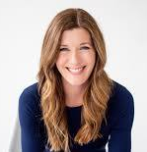
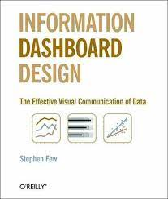
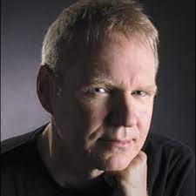
Steve Wexler
Edward Tufte
Cole Nussbaum Knaflic
Stephen Few

Slide 48
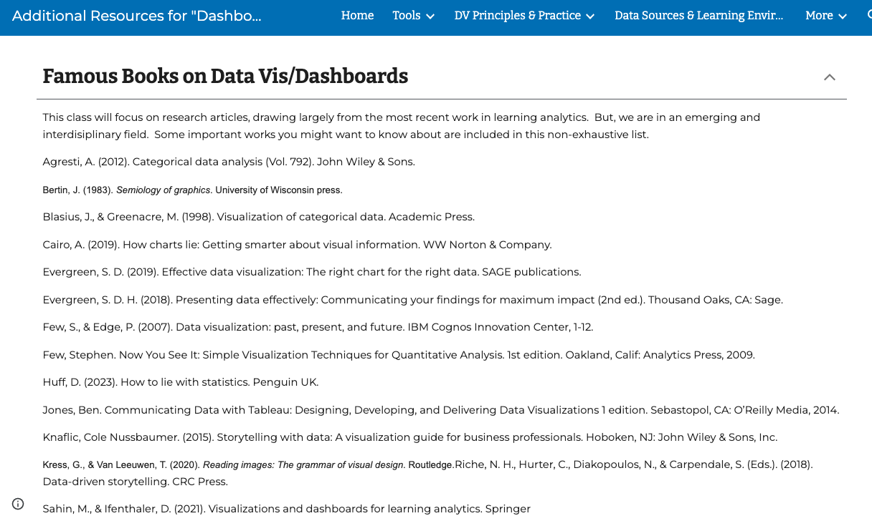

Slide 49
Tufte’s Data Visualization Principles
The representation of numbers, as physically measured on the surface of the graphic itself, should be directly proportional to the numerical quantities measured.
Clear, detailed, and thorough labeling should be used to defeat graphical distortion and ambiguity. Write out explanations of the data on the graphic itself. Label important events in the data.
Show data variation, not design variation.
In time-series displays of money, deflated and standardized units of monetary measurement are nearly always better than nominal units.
The number of information-carrying (variable) dimensions depicted should not exceed the number of dimensions in the data.
Graphics must not quote data out of context.

Slide 50
Data-Ink Ratio (Tufte) vs. Accessibility
Example A:
Example B:
Example C:
Example D:

Slide 51
Data-Ink Ratio (Tufte) vs. Accessibility
Example A:
Example B:
Example C:
Example D:

Slide 52
Data-Ink Ratio (Tufte) vs. Accessibility
Example A:
Example B:
Example C:
Example D:

Slide 53
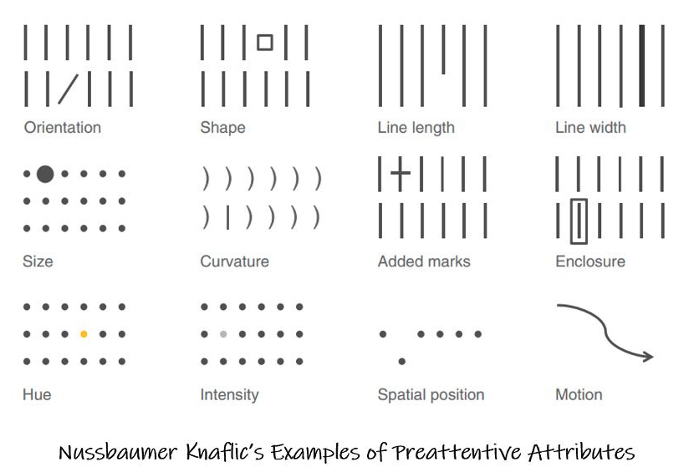

Slide 54
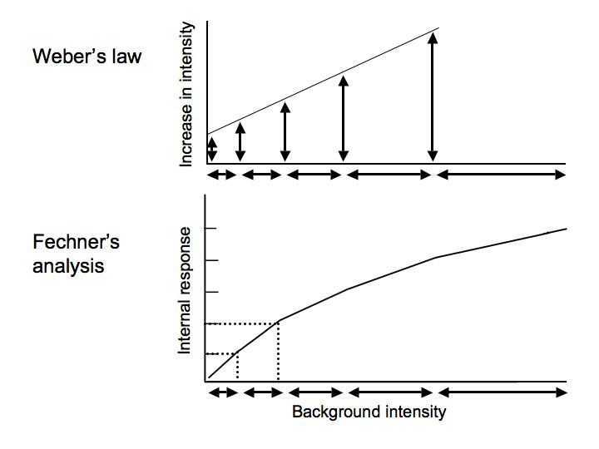
Image credit: David Heeger https://www.cns.nyu.edu/~david/courses/perception/lecturenotes/psychophysics/psychophysics.html

Slide 55
(Neurotypical) Human Perception is (Mainly) Logarithmic
Examples:
Neurological response rates appear logarithmic
Human auditory perception of
frequency range of hearing is logarithmic (Hz. Vs Barks scales)
loudness is somewhat logarithmic
Intensity is logarithmic
Amplitude less so
Luminosity in vison research is logarithmic
Numerical cognition (distance, magnitude, etc.) is logarithmic
Perception of heaviness is logarithmic
See also Stephen’s Power Law
Emerging research shows this does not always hold for Autistics

Slide 56
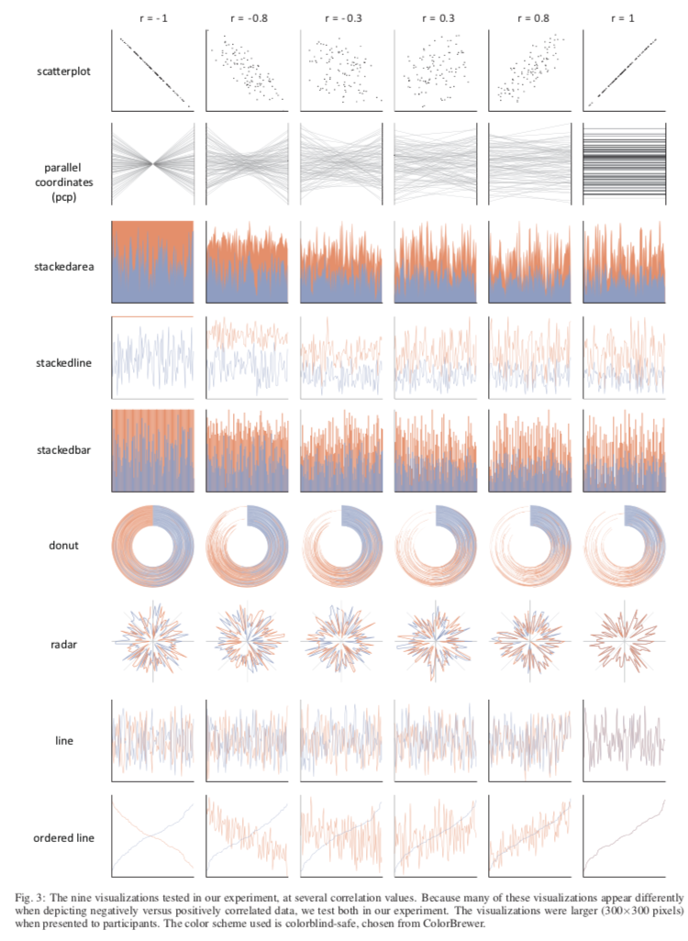
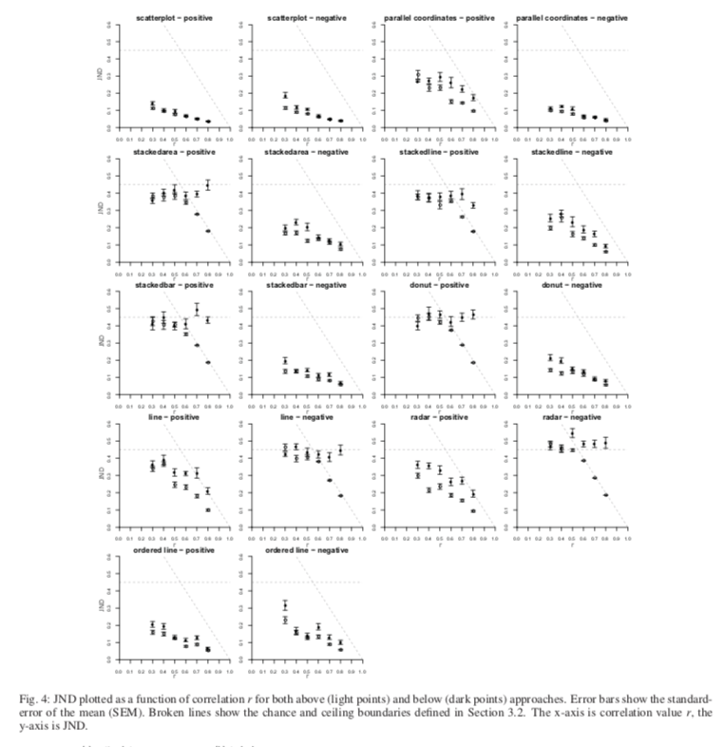
Harrison, L., Yang, F., Franconeri, S., & Chang, R. (2014). Ranking visualizations of correlation using weber's law. IEEE transactions on visualization and computer graphics, 20(12), 1943-1952.

Slide 57
Harrison, L., Yang, F., Franconeri, S., & Chang, R. (2014). Ranking visualizations of correlation using weber's law. IEEE transactions on visualization and computer graphics, 20(12), 1943-1952.

Slide 58
Harrison, L., Yang, F., Franconeri, S., & Chang, R. (2014). Ranking visualizations of correlation using weber's law. IEEE transactions on visualization and computer graphics, 20(12), 1943-1952.

Slide 59
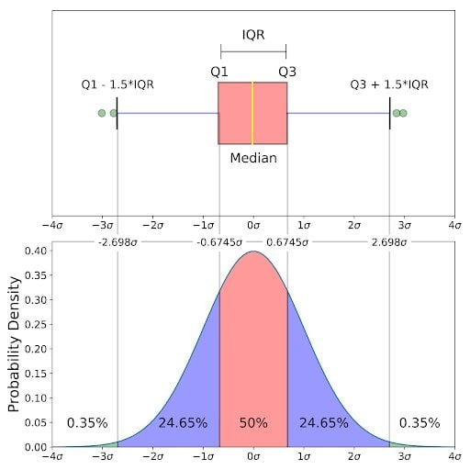
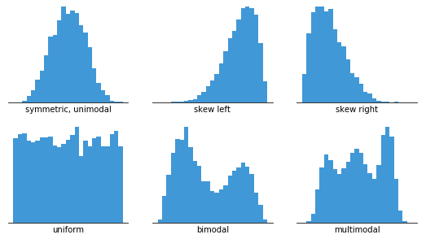
Charts that are good for exploring data
Box Plot
Line Chart
Image Credit: https://builtin.com/data-science/boxplot
Histogram
Scatterplot
Image Credit: https://chartio.com/learn/charts/histogram-complete-guide/

Slide 60
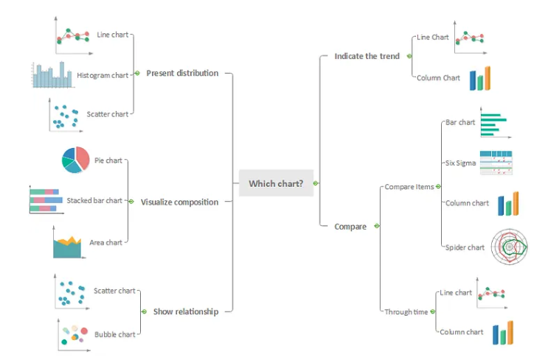
Choosing Charts
Image Credit: https://medium.com/@Lynia_Li/as-you-know-there-are-many-types-of-charts-to-be-used-in-data-visualization-54da9b97092e
Line Chart

Slide 61
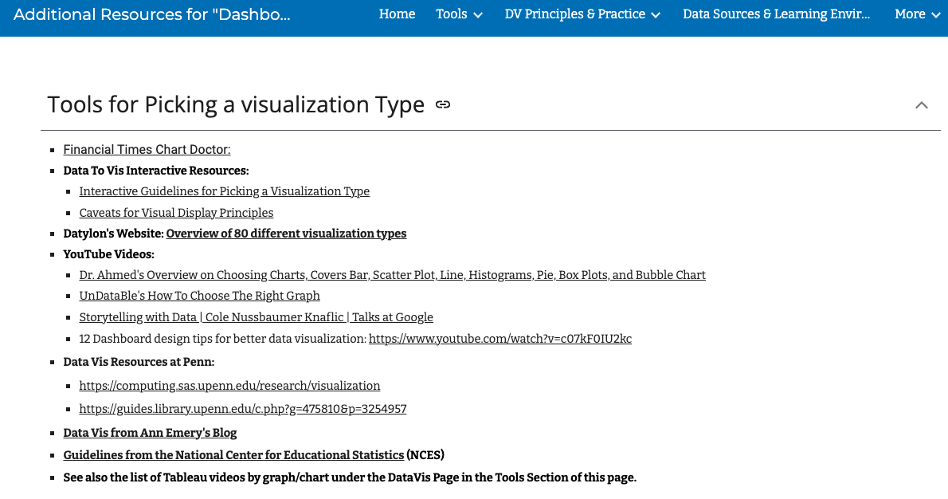

Slide 62
Bad Visualizations, Example 1

Slide 63
Bad Visualizations, Example 1
Pizza Math:
Vs.

Slide 64
Bad Visualizations, Example 1
Pizza Math:
Vs.
Multiple comparisons:
Shaded area
Arch length
Angle
Vs.

Slide 65
Bad Visualizations, Example 1
Pizza Math:
Vs.
Multiple comparisons:
Shaded area
Arch length
Angle
Vs.

Slide 66
Bad Visualizations, Example 1
Pizza Math:
Vs.
Multiple comparisons:
Shaded area
Arch length
Angle
Vs.

Slide 67
Bad Visualizations, Example 1
Pizza Math:
Vs.
Multiple comparisons:
Shaded area
Arch length
Angle
Vs.

Slide 68
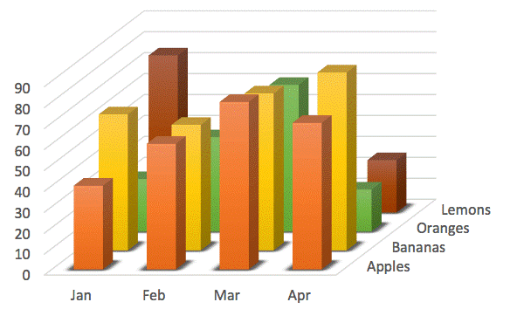
Bad Visualizations, Example 2
Image credit: https://www.futurelearn.com/info/courses/charting-and-data-visualization-in-excel/0/steps/231657

Slide 69
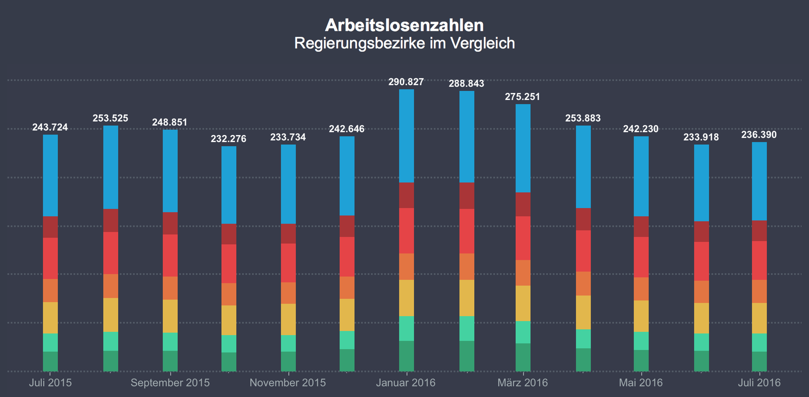
Bad Visualizations, Example 3
Image Credit: https://eagereyes.org/blog/2016/stacked-bars-are-the-worst

Slide 70
What should we do instead?
Pay attention to VISUALIZATION SCIENCES research
about how we process PREATTENTIVE ATTRIBUTES
about ACCESSIBILITY
including colorblindness
affects 1 in 12 men in the US (at least 3 students in a typical US classroom)
lower numbers for women in the US and for SOME other counties)
Including those with other sensory processing differences or disorders
i.e. unitization
Pay attention to known COGNITIVE BIASES that affect data interpretation

Slide 71
Double Encoding/ Colorblindness
Franconeri, S. L., Padilla, L. M., Shah, P., Zacks, J. M., & Hullman, J. (2021). The science of visual data communication: What works. Psychological Science in the public interest, 22(3), 110-161.

Slide 72
Franconeri, S. L., Padilla, L. M., Shah, P., Zacks, J. M., & Hullman, J. (2021). The science of visual data communication: What works. Psychological Science in the public interest, 22(3), 110-161.

Slide 73
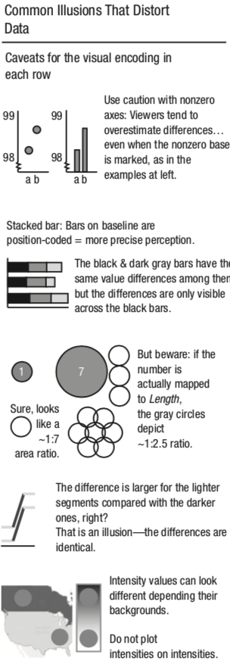
Franconeri, S. L., Padilla, L. M., Shah, P., Zacks, J. M., & Hullman, J. (2021). The science of visual data communication: What works. Psychological Science in the public interest, 22(3), 110-161.

Slide 74
Franconeri, S. L., Padilla, L. M., Shah, P., Zacks, J. M., & Hullman, J. (2021). The science of visual data communication: What works. Psychological Science in the public interest, 22(3), 110-161.

Slide 75
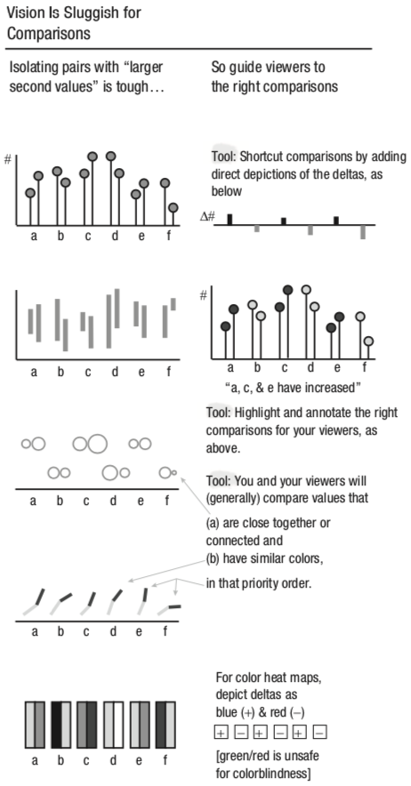
Franconeri, S. L., Padilla, L. M., Shah, P., Zacks, J. M., & Hullman, J. (2021). The science of visual data communication: What works. Psychological Science in the public interest, 22(3), 110-161.

Slide 76
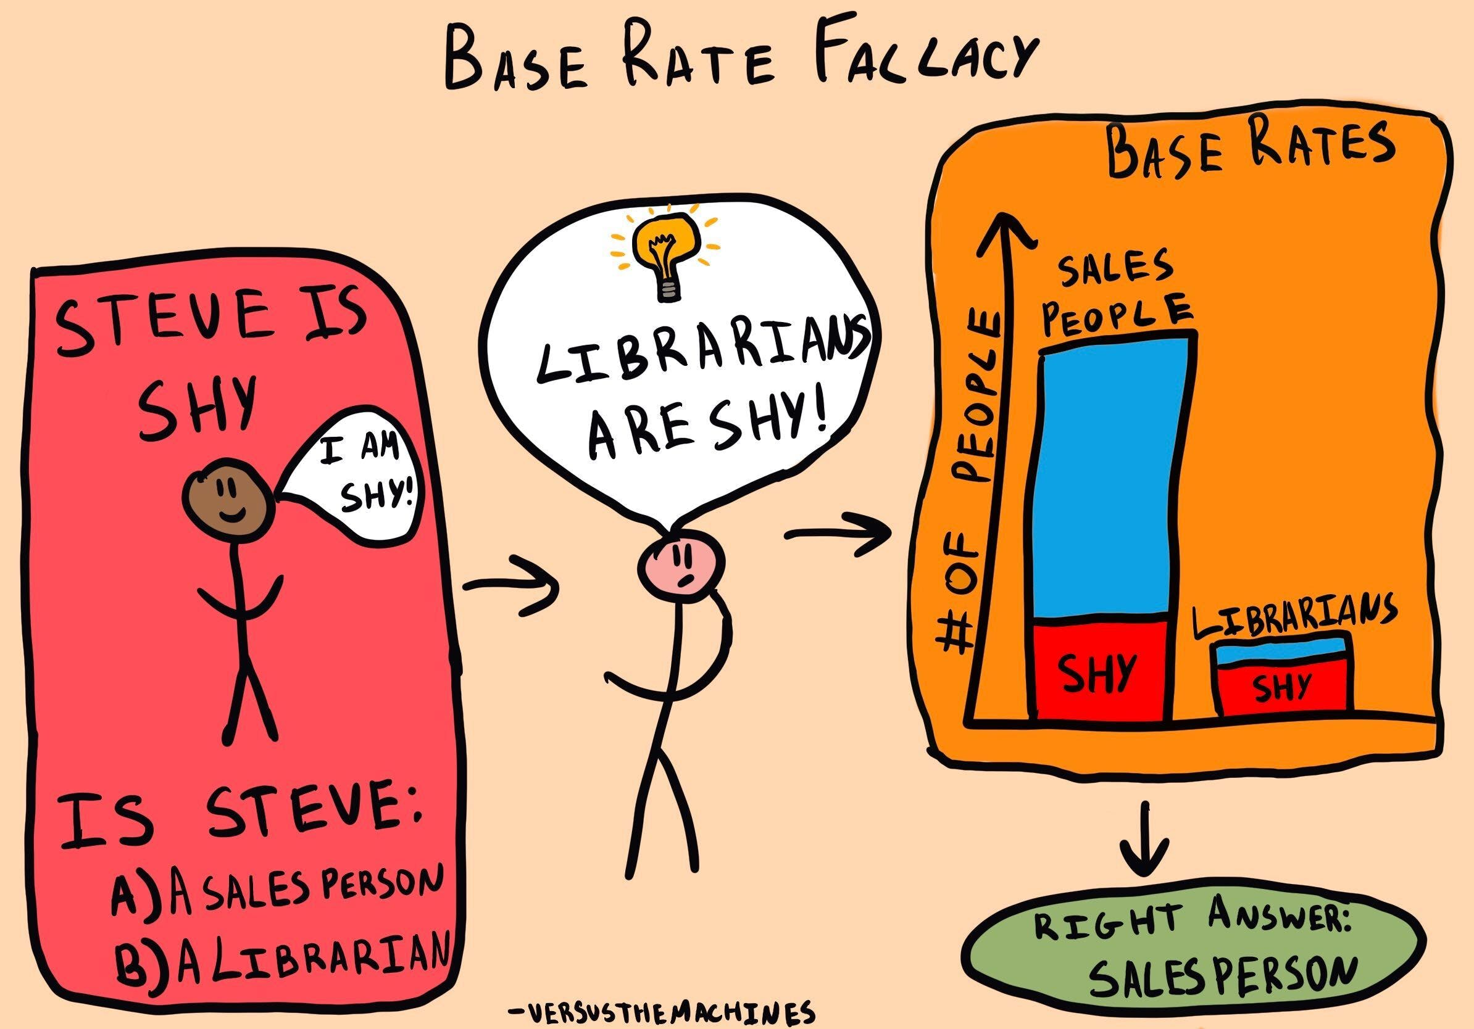
Image Credit: https://thedecisionlab.com/biases/base-rate-fallacy

Slide 77
Halo Effect
Summary: If someone is [good/bad] in one area, they are [good/bad] in unrelated area.
Ex: Those students who give me good evaluations are SOOOOO GOOD LOOKING!
Horn Effect

Slide 78
Anchoring Bias
Example A:
Student 21 did really well compared to Student 17!
Example B:
Both these students are failing!
Example C:
Both these students are well below average!

Slide 79
Anchoring Bias
Example A:
Student 21 did really well compared to Student 17!
Example B:
Both these students are failing!
Example C:
Both these students are well below average!

Slide 80
Anchoring Bias
Example A:
Student 21 did really well compared to Student 17!
Example B:
Both these students are failing!
Example C:
Both these students are well below average!

Slide 81
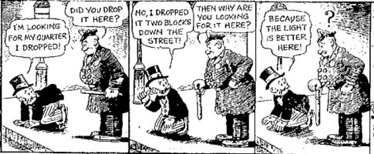
Streetlight Bias
Merit Badge for PERCENT CORRECT ANSWERS
You only find things when you look for them.
Merit Badge for NUMBER OF PROBLEMS ATTEMPTED
Image Credit: https://axispraxis.wordpress.com/2016/03/24/the-streetlight-effect-a-metaphor-for-knowledge-and-ignorance/

Slide 82
Big and Small Number Biases
Even extra geeky math nerds struggle with long decimal points
0.23591343
0.23502785
0.3205235
0.32415034
Left-hand bias in all numbers
Ask your sales team
Good evidence that humans start to struggle with numbers outside of “first base” in their counting systems
e.g., English is a base 10 language (NOT all languages are)
The bigger or smaller they are, the more they need contextualization
A million seconds is 11.6 days
A billion seconds is 11,574 days (30 years)
Example: Disease Reporting
Professionals report on number of people dead/infected per 100,000.
Standardizes across localities the way a percentage would
More interpretable
10 per 100k (.0001) people means you probably won’t know anybody who is sick.
1,000 per 100k (.01) means you might
Also keeps them from making errors in decimal points
.01 > .001

Slide 83
What data vis principles should we follow?
Data:Ink Ratio
vs. needs for redundancy/clarity (accessibility)
vs. focusing attention on insights (use both text and color)
Color
Avoid red/green contrasts and other nonaccessible combos
Use white for missing data?
Test all of your visualizations for colorblindness
Label
intentional use of 0 on the axis
in learning analytics, use positive labels to set goals
if large amounts of additional text is needed, then a table or a heat map might be better
Fair representation of numbers
Big and small numbers need contextualization
People are not great at interpreting values from angles and arches (straight lines are easier)
lines > area
Uncertainty needs to be carefully represented--it needs to be tested with your group

Slide 84
Intro to Data Vis for Learning Analytics Video E: Example Dashboard (2nd Draft)
Dr. Jaclyn Ocumpaugh, Associate Director, Penn Center for Learning Analytics

Slide 85
Professor Q’s Organic Chemistry
Big State University
March 1, 2024

Slide 86
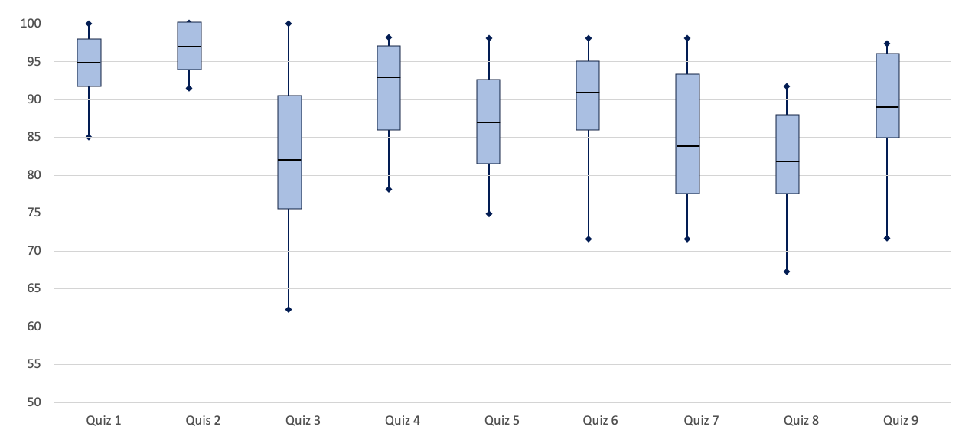
Professor Q’s Organic Chemistry
Big State University
March 1, 2024
Class Quiz Averages

Slide 87
Professor Q’s Organic Chemistry
Big State University
March 1, 2024
Class Quiz Averages

Slide 88
Professor Q’s Organic Chemistry
Big State University
March 1, 2024
Sort:
Quiz Average
Quiz 7
Quiz 6
Spotlight:
Students with failing average
Failing Quiz Grades
Quiz 6 Below Average
Class Quiz Averages

Slide 89
Professor Q’s Organic Chemistry
Big State University
March 1, 2024
Sort:
Quiz Average
Quiz 7
Quiz 6
Spotlight:
Students with failing average
Failing Quiz Grades
Quiz 6 Below Average
Class Quiz Averages

Slide 90
Professor Q’s Organic Chemistry
Big State University
March 1, 2024
Sort:
Quiz Average
Quiz 7
Quiz 6
Spotlight:
Students with failing average
Failing Quiz Grades
Quiz 6 Below Average
Class Quiz Averages

Slide 91
Professor Q’s Organic Chemistry
Big State University
March 1, 2024
Sort:
Quiz Average
Quiz 7
Quiz 6
Spotlight:
Students with failing average
Failing Quiz Grades
Quiz 6 Below Average
Class Quiz Averages

Slide 92
Professor Q’s Organic Chemistry
Big State University
March 1, 2024
Sort:
Quiz Average
Quiz 7
Quiz 6
Spotlight:
Students with failing average
Failing Quiz Grades
Quiz 6 Below Average
Class Quiz Averages

Slide 93
Professor Q’s Organic Chemistry
Big State University
March 1, 2024
Sort:
Quiz Average
Quiz 7
Quiz 6
Spotlight:
Students with failing average
Failing Quiz Grades
Quiz 6 Below Average
Class Quiz Averages
WHAT SHOULD WE ADD?
What other course-internal metrics are available?
What other course-external metrics are available?
What should the teacher do (agency & actionability) to help these students improve? What goals?

Slide 94
Intro to Data Vis for Learning Analytics Video F: Types of Data and Dashboards
Dr. Jaclyn Ocumpaugh, Associate Director, Penn Center for Learning Analytics

Slide 95
Video G: Types of Data and Dashboards
Objective: Explore various types of data visualizations applicable to learning analytics scenarios.
Overview of Data Types
Continuous, categorical
Types of data: assessment, process, and other
Overview of Dashboard and Data Types
Based on WHO, WHAT, and HOW
Descriptive, Predictive, Prescriptive.
Goals for Visualization in Learning Analytics
Mini Example with nudges and warnings

Slide 96
Data Types (Mathematical Classifications)
Continuous: time student spends in the classroom
Discrete: number of times the student clicks on a link
Ordinal: when a student rates their interest from 1 to 7
Nominal: whether or not the student qualifies for free/reduced price lunch (a measure of SES)

Slide 97
Data Types (Education)
Assessment Data: performance on assignments and tests
Process Data: how those assignments/tests were completed
Student Data: demographics, personal characteristics, learning disabilities, working memory, anxiety, etc.
Contextual Data: under what circumstances were these data collected
Homework/classwork
EVERYTHING ELSE

Slide 98
Typical Process Data in Learning Systems
Correct/Incorrect Answers
Mastery
Raw scores of correct/incorrect
Summary scores of correct/incorrect
Bayesian Knowledge Tracing (BKT)
Knowledge component
Skill
Cognitive Abilities
General Engagement
Actions
On-task behavior
On-task conversation
Help Seeking
Types of actions
Total # of actions
Timing, culmination of, etc.
Sequences
Affective States
Boredom
Confusion
Delight
Engaged Concentration
Frustration
Context
In the learning system
With/out other people involved
In a particular class/school/district/region
Disengagement
Gaming the System
Help Abuse
Without Thinking Fastidiously
Carelessness (Contextual Guess & Slip)
Answer Harvesting
Copying Answers using Multiple Existence (CAMEO)
Stop Out (quitting level)
Student Information
Demographics
LEARNING STYLES
Prior Knowledge
Surveys of Motivational Constructs, etc.
Multimodal Data
Self Regulated Learning (SRL)
Affective States
Mind wandering
Winne's SMART/COPES categories*
Wheel-spinning
Productive Persistence

Slide 99
Some of the Analyses:
Descriptive/Correlational Studies
Prediction Models
Discovery with Models
Types of Outcomes Modeled:
Short-term Learning
Long-term Learning
Interest/Motivational Constructs
Very Long-Term Outcomes
Which fourth grader will go to college?
How selective that college is?
Do they finish with a STEM degree?
What are we doing with it?

Slide 100
Types of Dashboards (who, what, how)
Academic Analytics (for administrators)
information on course enrollment over time
grades across different instructors (to predict how many students will need the next course in the sequence)
Learning Analytics (for people directly involved in learning)
Process and Assessment data
Could benefit from other kinds of data as well

Slide 101
Types of Dashboards (desc, pred, presc)
Descriptive: How is the student performing? (now)
Predictive: Based on historical data, how well is this student likely to do as the semester goes on? (in the future)
Prescriptive: Based on how the student is doing now (and usually historical data), what should the student do to improve? (to change the future! think PRESCRIPTION/Rx)

Slide 102
Professor Q’s Organic Chemistry
Big State University
March 1, 2024
Sort:
Quiz Average
Quiz 7
Quiz 6
Spotlight:
Students with failing average
Failing Quiz 6 Grades
Quiz 6 Below Average
Class Quiz Averages
WHAT SHOULD WE ADD?
What other course-internal metrics are available?
What other course-external metrics are available?
What should the teacher do (agency & actionability) to help these students improve? What goals?

Slide 103
Professor Q’s Organic Chemistry
Big State University
March 1, 2024
Sort:
Quiz Average
Quiz 7
Quiz 6
Spotlight:
Students with failing average
Failing Quiz 6 Grades
Quiz 6 Below Average
Class Quiz Averages
WARNINGS THAT ARE PREDICTIVE BUT NOT PRESCRIPTIVE
WARNING 1:
Students with an average below 85 or with more than two failing quiz grades are not likely to pass the final:
Student 7
Student 13
Student 21
Student 22
WARNING 2:
Students who scored less than a 50 on any exam are not likely to pass the final exam
Student 17

Slide 104
Professor Q’s Organic Chemistry
Big State University
March 1, 2024
Sort:
Quiz Average
Quiz 7
Quiz 6
Spotlight:
Students with failing average
Failing Quiz 6 Grades
Quiz 6 Below Average
Class Quiz Averages
NUDGES THAT ARE PRESCRIPTIVE BUT NOT PREDICTIVE
Nudge 1:
Students who perform below average on Quiz 6 need remediation on the calculus involved in reaction times, especially if they also did poorly on Quiz 3.
Nudge 2:
Students who scored C or lower on Quiz 7 spent less time doing homework.

Slide 105
Supporting students requires all:
Descriptive data helps us see how students are doing.
Predictive data helps us know how likely that is to matter.
Assessment data lets us know how well a student understands certain information (usually).
Process data can help us figure out what students need to do.
Prescriptive instructions can help students and teachers figure out how to improve learning.

Slide 106
Intro to Data Vis for Learning Analytics Video G: Theory and Data in LA
Dr. Jaclyn Ocumpaugh, Associate Director, Penn Center for Learning Analytics

Slide 107
Video H: Theory and Data in LA
Objective: What theories are being use? And what could we do better?
Review articles looking at the field
Data vis theories
Educational theories
Social comparison
Regression to the mean
Do you like who you are being compared to?
Other issues
What else could we report?
What do teachers want?
What student-level factors might help?
How do we move forward?

Slide 108
Vieira et al.’s (2018) dashboard lit review dimensions
Connection with Visualization Background (CVB) = follows good data vis strategies
Connection with Educational Theory (CET) = measures and recommends things important to learning (is pedagogically sound)
Sophistication of Visualization (SoV) = uses unusual or fancy looking graphics
Vieira, C., Parsons, P., & Byrd, V. (2018). Visual learning analytics of educational data: A systematic literature review and research agenda. Computers & Education, 122, 119-135.

Slide 109
Vieira et al.’s (2018) dashboard lit review dimensions
Connection with Visualization Background (CVB) = follows good data vis strategies
Connection with Educational Theory (CET) = measures and recommends things important to learning (is pedagogically sound)
Sophistication of Visualization (SoV) = uses unusual or fancy looking graphics
Vieira, C., Parsons, P., & Byrd, V. (2018). Visual learning analytics of educational data: A systematic literature review and research agenda. Computers & Education, 122, 119-135.

Slide 110
Vieira et al.’s (2018) dashboard lit review dimensions
Connection with Visualization Background (CVB) = follows good data vis strategies
Connection with Educational Theory (CET) = measures and recommends things important to learning (is pedagogically sound)
Sophistication of Visualization (SoV) = uses unusual or fancy looking graphics
Vieira, C., Parsons, P., & Byrd, V. (2018). Visual learning analytics of educational data: A systematic literature review and research agenda. Computers & Education, 122, 119-135.

Slide 111
Vieira et al.’s (2018) dashboard lit review dimensions
Connection with Visualization Background (CVB) = follows good data vis strategies
Connection with Educational Theory (CET) = measures and recommends things important to learning (is pedagogically sound)
Sophistication of Visualization (SoV) = uses unusual or fancy looking graphics
Vieira, C., Parsons, P., & Byrd, V. (2018). Visual learning analytics of educational data: A systematic literature review and research agenda. Computers & Education, 122, 119-135.

Slide 112
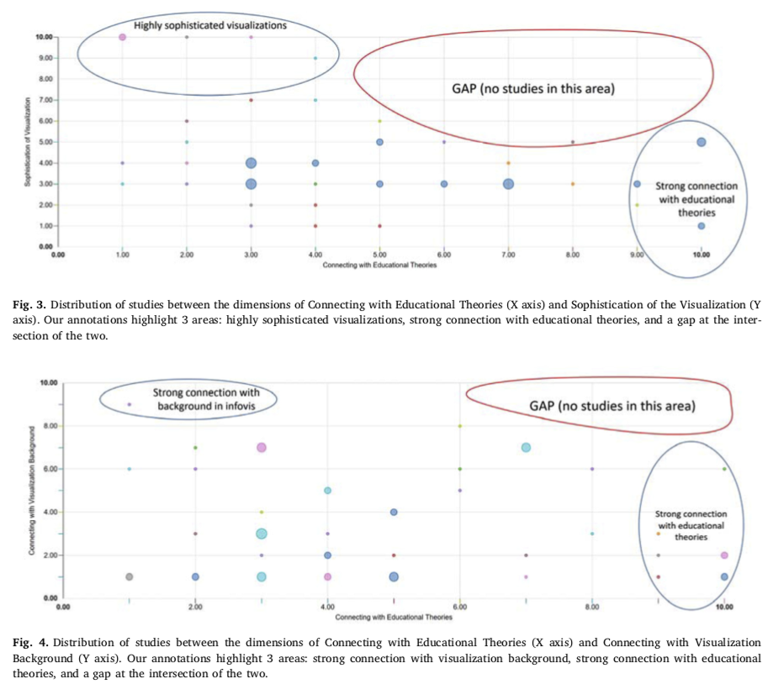
Sophistication of Visualization (SoV)
Connecting with Educational Theory (CET)
Connecting with Visualization Background (CVB)
Connecting with Educational Theory (CET)

Slide 113
Sophistication of Visualization (SoV)
YOUR GOAL
Connecting with Educational Theory (CET)
Connecting with Visualization Background (CVB)
Connecting with Educational Theory (CET)

Slide 114
Dashboard Names
ELLI
EmotionModule
Feedback System
LAD
LEA’s Box OLM
Mastery Grids
Mastery Grids
NextTELL IOLM
PADA
PeerLA
QMCU
SAM (Student Activity Meter)
SCALE, MI-DASH
Student progress page
Tracer
VACC
WiREAD
Jivet, I., Scheffel, M., Drachsler, H., & Specht, M. (2017). Awareness is not enough: Pitfalls of learning analytics dashboards in the educational practice. In Data Driven Approaches in Digital Education: 12th European Conference on Technology Enhanced Learning, EC-TEL 2017, Tallinn, Estonia, September 12–15, 2017, Proceedings 12 (pp. 82-96). Springer International Publishing.

Slide 115
Jivet, I., Scheffel, M., Drachsler, H., & Specht, M. (2017). Awareness is not enough: Pitfalls of learning analytics dashboards in the educational practice. In Data Driven Approaches in Digital Education: 12th European Conference on Technology Enhanced Learning, EC-TEL 2017, Tallinn, Estonia, September 12–15, 2017, Proceedings 12 (pp. 82-96). Springer International Publishing.

Slide 116
Valle, N., Antonenko, P., Dawson, K., & Huggins‐Manley, A. C. (2021). Staying on target: A systematic literature review on learner‐facing learning analytics dashboards. British Journal of Educational Technology, 52(4), 1724-1748.

Slide 117
Valle, N., Antonenko, P., Dawson, K., & Huggins‐Manley, A. C. (2021). Staying on target: A systematic literature review on learner‐facing learning analytics dashboards. British Journal of Educational Technology, 52(4), 1724-1748.

Slide 118
Major considerations before planning your dashboard.
What you measure is what you get.
Streetlight effects
Social comparison
Make sure your target audience is capable of acting on what you measure
Agency
Social comparison

Slide 119
Social Comparison Theory
“we establish our self-worth by comparing ourselves to others when there are no objective means of comparison”
Classroom research shows:
Beneficial effect for “comparison to self-selected peers who perform slightly better”
No effects were found for bigger performance gaps
Yet this theory/research is rarely used to inform the design of dashboards (only 3 dashboard studies)
Jivet, I., Scheffel, M., Drachsler, H., & Specht, M. (2017). Awareness is not enough: Pitfalls of learning analytics dashboards in the educational practice. In Data Driven Approaches in Digital Education: 12th European Conference on Technology Enhanced Learning, EC-TEL 2017, Tallinn, Estonia, September 12–15, 2017, Proceedings 12 (pp. 82-96). Springer International Publishing.

Slide 120
If we rely solely on social comparison for motivation, ““being better than others”
becomes the norm in terms of what defines a successful learner.”
Jivet, I., Scheffel, M., Drachsler, H., & Specht, M. (2017). Awareness is not enough: Pitfalls of learning analytics dashboards in the educational practice. In Data Driven Approaches in Digital Education: 12th European Conference on Technology Enhanced Learning, EC-TEL 2017, Tallinn, Estonia, September 12–15, 2017, Proceedings 12 (pp. 82-96). Springer International Publishing.

Slide 121
Achievement Goal Theory
Goal differentiations
Performance goals (social comparison would be motivating)
Mastery goals (social comparison would not be motivating)
Beheshitha et al. [2] shows that students with mastery orientation did not like visualizations with social comparison
But only one dashboard allows students to choose
Jivet, I., Scheffel, M., Drachsler, H., & Specht, M. (2017). Awareness is not enough: Pitfalls of learning analytics dashboards in the educational practice. In Data Driven Approaches in Digital Education: 12th European Conference on Technology Enhanced Learning, EC-TEL 2017, Tallinn, Estonia, September 12–15, 2017, Proceedings 12 (pp. 82-96). Springer International Publishing.

Slide 122
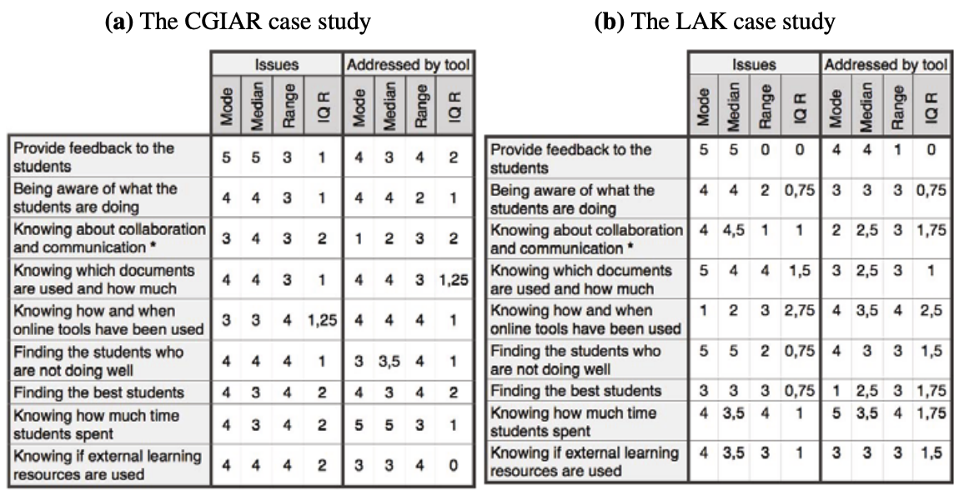
Likert Scale: how important are these 9 data issues to the teacher
(‘1 - not relevant’ to ‘5 - very important’).
Student Activity Meter (SAM) from Govaerts et al (2010)

Slide 123
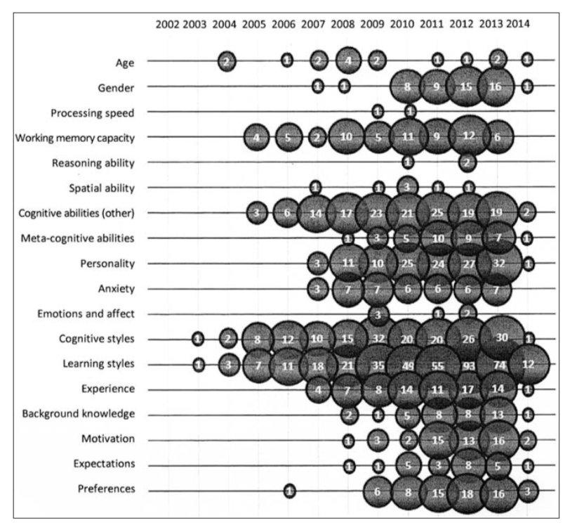
Citations Timeline
from Nakic et al (2015)
What student characteristics were being modeled?
Nakic, J., Granic, A., & Glavinic, V. (2015). Anatomy of student models in adaptive learning systems: A systematic literature review of individual differences from 2001 to 2013. Journal of Educational Computing Research, 51(4), 459-489.

Slide 124
Summary
The field is slowly starting to move from the space where we are only worried about how cool the graphics are
More work needs to be done to connect to theory to ensure appropriate pedagogy and motivational techniques are being used
We need to move out of the social comparison space
There is also room to look at more contextual factors
We need to think about the STORIES involved with these students so that we can work to make our dashboards more actionable. Not everything will be related to what is happening in the classroom.

Slide 125
Intro to Data Vis for Learning Analytics Video H: Story Telling with our Example Dashboard
Dr. Jaclyn Ocumpaugh, Associate Director, Penn Center for Learning Analytics

Slide 126
Professor Q’s Organic Chemistry
Big State University
March 1, 2024
Sort:
Quiz Average
Quiz 7
Quiz 6
Spotlight:
Students with failing average
Failing Quiz Grades
Quiz 6 Below Average
Class Quiz Averages

Slide 127
Example: 22 students in Organic Chemistry
 | student 1 | student 2 | student 3 | student 4 | student 5 | student 6 | student 7 | student 8 | student 9 | student 10 | student 11 | student 12 | student 13 | student 14 | student 15 | student 16 | student 17 | student 18 | student 19 | student 20 | student 21 | student 22
Quiz 1 | 97 | 99 | 93 | 100 | 98 | 91 | 92 | 98 | 98 | 93 | 95 | 100 | 90 | 95 | 97 | 93 | 95 | 92 | 93 | 92 | 85 | 99
Quis 2 | 100 | 100 | 98 | 97 | 97 | 100 | 98 | 91 | 93 | 95 | 100 | 98 | 98 | 100 | 95 | 97 | 93 | 92 | 97 | 98 | 83 | 100
Quiz 3 | 75 | 100 | 87 | 80 | 89 | 90 | 60 | 85 | 93 | 92 | 97 | 98 | 70 | 82 | 83 | 80 | 45 | 76 | 80 | 81 | 62 | 90
Quiz 4 | 88 | 87 | 93 | 92 | 97 | 98 | 78 | 85 | 93 | 96 | 97 | 98 | 78 | 84 | 87 | 98 | 91 | 93 | 95 | 95 | 63 | 97
Quiz 5 | 92 | 97 | 98 | 78 | 85 | 93 | 96 | 93 | 97 | 78 | 84 | 87 | 98 | 91 | 93 | 75 | 85 | 93 | 80 | 85 | 78 | 83
Quiz 6 | 91 | 93 | 87 | 85 | 95 | 98 | 93 | 97 | 86 | 89 | 89 | 98 | 91 | 93 | 75 | 85 | 93 | 94 | 92 | 96 | 65 | 98
Quiz 2 | 92 | 78 | 85 | 93 | 96 | 93 | 97 | 78 | 84 | 78 | 85 | 93 | 96 | 93 | 97 | 78 | 84 | 87 | 98 | 91 | 71 | 75
Quis 3 | 90 | 89 | 84 | 90 | 85 | 90 | 72 | 85 | 80 | 78 | 87 | 82 | 75 | 78 | 88 | 92 | 78 | 88 | 78 | 84 | 68 | 71
Quiz 7 | 98 | 85 | 93 | 96 | 93 | 97 | 78 | 84 | 87 | 98 | 85 | 93 | 96 | 93 | 97 | 78 | 84 | 87 | 98 | 91 | 72 | 85
Which quizzes are we worried about?

Slide 128
Example: 22 students in Organic Chemistry
 | student 1 | student 2 | student 3 | student 4 | student 5 | student 6 | student 7 | student 8 | student 9 | student 10 | student 11 | student 12 | student 13 | student 14 | student 15 | student 16 | student 17 | student 18 | student 19 | student 20 | student 21 | student 22
Quiz 1 | 97 | 99 | 93 | 100 | 98 | 91 | 92 | 98 | 98 | 93 | 95 | 100 | 90 | 95 | 97 | 93 | 95 | 92 | 93 | 92 | 85 | 99
Quis 2 | 100 | 100 | 98 | 97 | 97 | 100 | 98 | 91 | 93 | 95 | 100 | 98 | 98 | 100 | 95 | 97 | 93 | 92 | 97 | 98 | 83 | 100
Quiz 3 | 75 | 100 | 87 | 80 | 89 | 90 | 60 | 85 | 93 | 92 | 97 | 98 | 70 | 82 | 83 | 80 | 45 | 76 | 80 | 81 | 62 | 90
Quiz 4 | 88 | 87 | 93 | 92 | 97 | 98 | 78 | 85 | 93 | 96 | 97 | 98 | 78 | 84 | 87 | 98 | 91 | 93 | 95 | 95 | 63 | 97
Quiz 5 | 92 | 97 | 98 | 78 | 85 | 93 | 96 | 93 | 97 | 78 | 84 | 87 | 98 | 91 | 93 | 75 | 85 | 93 | 80 | 85 | 78 | 83
Quiz 6 | 91 | 93 | 87 | 85 | 95 | 98 | 93 | 97 | 86 | 89 | 89 | 98 | 91 | 93 | 75 | 85 | 93 | 94 | 92 | 96 | 65 | 98
Quiz 2 | 92 | 78 | 85 | 93 | 96 | 93 | 97 | 78 | 84 | 78 | 85 | 93 | 96 | 93 | 97 | 78 | 84 | 87 | 98 | 91 | 71 | 75
Quis 3 | 90 | 89 | 84 | 90 | 85 | 90 | 72 | 85 | 80 | 78 | 87 | 82 | 75 | 78 | 88 | 92 | 78 | 88 | 78 | 84 | 68 | 71
Quiz 7 | 98 | 85 | 93 | 96 | 93 | 97 | 78 | 84 | 87 | 98 | 85 | 93 | 96 | 93 | 97 | 78 | 84 | 87 | 98 | 91 | 72 | 85
Which quizzes are we worried about?

Slide 129
Example: 22 students in Organic Chemistry
 | student 1 | student 2 | student 3 | student 4 | student 5 | student 6 | student 7 | student 8 | student 9 | student 10 | student 11 | student 12 | student 13 | student 14 | student 15 | student 16 | student 17 | student 18 | student 19 | student 20 | student 21 | student 22
Quiz 1 | 97 | 99 | 93 | 100 | 98 | 91 | 92 | 98 | 98 | 93 | 95 | 100 | 90 | 95 | 97 | 93 | 95 | 92 | 93 | 92 | 85 | 99
Quis 2 | 100 | 100 | 98 | 97 | 97 | 100 | 98 | 91 | 93 | 95 | 100 | 98 | 98 | 100 | 95 | 97 | 93 | 92 | 97 | 98 | 83 | 100
Quiz 3 | 75 | 100 | 87 | 80 | 89 | 90 | 60 | 85 | 93 | 92 | 97 | 98 | 70 | 82 | 83 | 80 | 45 | 76 | 80 | 81 | 62 | 90
Quiz 4 | 88 | 87 | 93 | 92 | 97 | 98 | 78 | 85 | 93 | 96 | 97 | 98 | 78 | 84 | 87 | 98 | 91 | 93 | 95 | 95 | 63 | 97
Quiz 5 | 92 | 97 | 98 | 78 | 85 | 93 | 96 | 93 | 97 | 78 | 84 | 87 | 98 | 91 | 93 | 75 | 85 | 93 | 80 | 85 | 78 | 83
Quiz 6 | 91 | 93 | 87 | 85 | 95 | 98 | 93 | 97 | 86 | 89 | 89 | 98 | 91 | 93 | 75 | 85 | 93 | 94 | 92 | 96 | 65 | 98
Quiz 2 | 92 | 78 | 85 | 93 | 96 | 93 | 97 | 78 | 84 | 78 | 85 | 93 | 96 | 93 | 97 | 78 | 84 | 87 | 98 | 91 | 71 | 75
Quis 3 | 90 | 89 | 84 | 90 | 85 | 90 | 72 | 85 | 80 | 78 | 87 | 82 | 75 | 78 | 88 | 92 | 78 | 88 | 78 | 84 | 68 | 71
Quiz 7 | 98 | 85 | 93 | 96 | 93 | 97 | 78 | 84 | 87 | 98 | 85 | 93 | 96 | 93 | 97 | 78 | 84 | 87 | 98 | 91 | 72 | 85
Which quizzes are we worried about?

Slide 130
Example: 22 students in Organic Chemistry
 | student 1 | student 2 | student 3 | student 4 | student 5 | student 6 | student 7 | student 8 | student 9 | student 10 | student 11 | student 12 | student 13 | student 14 | student 15 | student 16 | student 17 | student 18 | student 19 | student 20 | student 21 | student 22
Quiz 1 | 97 | 99 | 93 | 100 | 98 | 91 | 92 | 98 | 98 | 93 | 95 | 100 | 90 | 95 | 97 | 93 | 95 | 92 | 93 | 92 | 85 | 99
Quis 2 | 100 | 100 | 98 | 97 | 97 | 100 | 98 | 91 | 93 | 95 | 100 | 98 | 98 | 100 | 95 | 97 | 93 | 92 | 97 | 98 | 83 | 100
Quiz 3 | 75 | 100 | 87 | 80 | 89 | 90 | 60 | 85 | 93 | 92 | 97 | 98 | 70 | 82 | 83 | 80 | 45 | 76 | 80 | 81 | 62 | 90
Quiz 4 | 88 | 87 | 93 | 92 | 97 | 98 | 78 | 85 | 93 | 96 | 97 | 98 | 78 | 84 | 87 | 98 | 91 | 93 | 95 | 95 | 63 | 97
Quiz 5 | 92 | 97 | 98 | 78 | 85 | 93 | 96 | 93 | 97 | 78 | 84 | 87 | 98 | 91 | 93 | 75 | 85 | 93 | 80 | 85 | 78 | 83
Quiz 6 | 91 | 93 | 87 | 85 | 95 | 98 | 93 | 97 | 86 | 89 | 89 | 98 | 91 | 93 | 75 | 85 | 93 | 94 | 92 | 96 | 65 | 98
Quiz 7 | 92 | 78 | 85 | 93 | 96 | 93 | 97 | 78 | 84 | 78 | 85 | 93 | 96 | 93 | 97 | 78 | 84 | 87 | 98 | 91 | 71 | 75
Quiz 8 | 90 | 89 | 84 | 90 | 85 | 90 | 72 | 85 | 80 | 78 | 87 | 82 | 75 | 78 | 88 | 92 | 78 | 88 | 78 | 84 | 68 | 71
Quiz 9 | 98 | 85 | 93 | 96 | 93 | 97 | 78 | 84 | 87 | 98 | 85 | 93 | 96 | 93 | 97 | 78 | 84 | 87 | 98 | 91 | 72 | 85
Which quizzes are we worried about?

Slide 131
Story-telling goes better with names…
Student 21 is Jerry
Student 7 is Freddy
Student 17 is June
Student 13 is Rajit
Student 22 is Laura

Slide 132
Once upon a time… (part 1)
…there was an organic chemistry class at BigState UniversityTM that had 22 students. Through an early alert system in the class dashboard, five were highlighted as being likely to fail the final exam. Their names were Jerry, Laura, June, Rajit, and Freddy.

Slide 133
Professor Q’s Organic Chemistry
Big State University
March 1, 2024
Sort:
Quiz Average
Quiz 7
Quiz 6
Spotlight:
Students with failing average
Failing Quiz Grades
Quiz 6 Below Average
Class Quiz Averages
Laura
Freddy
Rajit
June
Jerry

Slide 134
Once upon a time… (part 2)
Jerry seems to be doing the worst. He did okay on the first two quizzes, but he’s been scoring lower since then.

Slide 135
Example: Jerry’s Org. Chem Quiz Grades

Slide 136
Example: Org. Chem Quiz Averages

Slide 137
Example: Jerry vs. Class

Slide 138
Example: Jerry vs. Class

Slide 139
Example: Jerry’s Org. Chem Quiz Grades

Slide 140
Example: Avg Quiz Grades Org Chem

Slide 141
Example: Jerry’s Org. Chem Quiz Grades

Slide 142
Once upon a time… (part 3)
Hmmm….actually, it doesn’t look like Jerry did that great on the first two quizzes either, once we have the class averages and standard deviations as an anchoring device. Let’s keep looking using those!

Slide 143
Example: Jerry’s Org. Chem Quiz Grades

Slide 144
Once upon a time… (part 4)
Jerry seems to be doing the worst. He did okay on the first two quizzes, but he’s been scoring lower since then. And Jerry was struggling from the very beginning. In fact, his scores are lower than the other struggling students identified by this system.
Laura, June, Rajit, and Freddy are also struggling, but their scores are better than Jerry’s.

Slide 145
Example: June’s Org. Chem Quiz Grades

Slide 146
Example: Rajit’s Org. Chem Quiz Grades

Slide 147
Example: Freddy’s Org. Chem Quiz Grades

Slide 148
Example: Laura’s Org. Chem Quiz Grades

Slide 149
Once upon a time… (part 5)
After looking at how these students compare to the box and whisker plots, their instructor, Doc Cool, looks back at the dashboard.

Slide 150
Professor Q’s Organic Chemistry
Big State University
March 1, 2024
Sort:
Quiz Average
Quiz 7
Quiz 6
Spotlight:
Students with failing average
Failing Quiz Grades
Quiz 6 Below Average
Show More Data:
Hours studied
Library worker time
Football team practice
Class Quiz Averages
Laura
Freddy
Rajit
June
Jerry

Slide 151
Once upon a time… (part 5)
There’s no process data on the dashboard, so Doc Cool decides to tell these students to study more!
No wait! She finds some other drill down options to look at individual students!
She looks at the first student, Jerry, and is horrified to see he is studying more than 10 or 20 hours a week on just her class! How is he possibly able to manage that with his other courses?

Slide 152
Example: Jerry’s Org. Chem Quiz Grades
50
45
40
35
30
25
20
15
10
5
0
Hours Studied outside of class that week

Slide 153
Once upon a time… (part 6)
Armed with this new information, Doc Cool calls Jerry’s advisor. She finds out that Jerry is a first generation college student. He has a scholarship so he does not have to have a job, but his home high school had no calculus courses.
So, even though Jerry aced his chemistry courses in high school, he is now struggling in organic chemistry as he tries to take Cal 1 at the same time.
Doc Cool automagically convinces her dashboard provider to look at the quizzes in her class that require significant knowledge of calculus.

Slide 154
Example: Jerry’s Org. Chem Quiz Grades

Slide 155
Example: Jerry’s Org. Chem Quiz Grades

Slide 156
Example: Jerry’s Org. Chem Quiz Grades
50
45
40
35
30
25
20
15
10
5
0
Hours Studied outside of class that week

Slide 157
Once upon a time… (part 7)
It’s now clear that Jerry is working very hard, but needs additional support in calculus. Doc Cool is relieved that BigState UniversityTM is so dedicated to providing free tutoring to deserving students, and she arranges for Jerry to get additional calculus tutoring that cuts his study time in half going forward!
She leaves the calculus setting on when she pulls up Rajit’s information.

Slide 158
Once upon a time… (part 7)
It’s now clear that Jerry is working very hard, but needs additional support in calculus. Doc Cool is relieved that BigState UniversityTM is so dedicated to providing free tutoring to deserving students, and she arranges for Jerry to get additional calculus tutoring that cuts his study time in half going forward!
She leaves the calculus setting on when she pulls up Rajit’s information. First she looks at just his grades, then she adds his study hours. She doesn’t understand WHY he wasn’t studying in week #3, but then she see’s he has a job at the library!

Slide 159
Example: Rajit’s Org. Chem Quiz Grades

Slide 160
Example: Rajit’s Org. Chem Quiz Grades
50
45
40
35
30
25
20
15
10
5
0
Quiz Grades
Hours Studied outside of class that week

Slide 161
Example: Rajit’s Org. Chem Quiz Grades
60 hrs
20 hrs
20 hrs
20 hrs
18 hrs
8 hrs
10 hrs
10 hrs
5 hrs

Slide 162
Example: Rajit’s Org. Chem Quiz Grades
50
45
40
35
30
25
20
15
10
5
0
60 hrs
Hours Studied outside of class that week
20 hrs
20 hrs
20 hrs
18 hrs
8 hrs
10 hrs
10 hrs
5 hrs
Quizzes that contained more than 70% calculus problems

Slide 163
Once upon a time… (part 7)
Mystery solved! Doc Cool talks to the library supervisor who tells her that Rajit felt bad when another member was out sick. The supervisor assures Doc Cool that they’ll be sure to push back on Rajit when he says he can fill in, and they certainly won’t let him go over 40 hours in one week again!
Doc Cool is thrilled that Rajit is such a responsible student. She makes sure he knows what to study to make up for what he missed that week. Given his relatively strong performance otherwise, she is not worried.
But now she must figure out what is happening with the other students!

Slide 164
Example: June’s Org. Chem Quiz Grades

Slide 165
Example: Freddy’s Org. Chem Quiz Grades

Slide 166
Once upon a time… (part 8)
June and Freddy are both working from off campus, and so the learning system where they do their homework and reading is not logging any of those hours. Neither of them work for the library, and they don’t belong to the football team. So, Doc Cool doesn’t have any context data to figure out what might be happening.
She uses her lunch break to calls Mr. Knight, their advisor, to see what he knows about their situation. Mr. Knight doesn’t know anything about Freddy, but says that June met with him in week #4, and she had just flown back from her mother’s funeral. Doc Cool looks at her dashboard. Wow, she must have had a shock and then thrown herself right back into her studies. She offers to let June re-take Quiz 3

Slide 167
Example: June’s Org. Chem Quiz Grades

Slide 168
Once upon a time… (part 8)
Now, what to do about Freddy? Doc Cool talks to her TA, Kym Aververked, who says Freddy usually participates in class. He even helps his other students. But there have been a couple of times that she has seen Freddy at the Peanut Barrel for “Thirsty Thursdays.” Kym noticed that Freddy seemed a little under the weather during the Friday morning quizzes after that.
What days were those again? Kym checks her calendar.

Slide 169
Example: Freddy’s Org. Chem Quiz Grades
Week’s Freddy went to “Thirsty Thursdays” at the Peanut Barrell

Slide 170
Once upon a time… (part 9)
Doc Cool is annoyed. She is running late for a faculty meeting. Plus, she likes Freddy. She does not want him to fail the final, but she does not want to scold someone who is clearly an asset to the class.
Doc Cool asks Kym to make sure that Freddy is studying, and they send him some extra practice sets to get him ready for the final exam.

Slide 171
Once upon a time… (part 10)

Slide 172
Intro to Data Vis for Learning Analytics Video I: The Future of Dashboards
Dr. Jaclyn Ocumpaugh, Associate Director, Penn Center for Learning Analytics

Slide 173
We need lots of data!
Descriptive data helps us see how students are doing.
Predictive data helps us know how likely that is to matter.
Assessment data lets us know how well a student understands certain information (usually).
Process data can help us figure out what students need to do.
Prescriptive instructions can help students and teachers figure out how to improve learning.

Slide 174
We need theory!
To guide what we measure
To make sure that we are giving pedagogically sound prescriptive advice with our dashboards
To design effective visualizations

Slide 175
We won’t get all the data we might need
Because of privacy concerns
Because of data collection failures
Because humans are unique individuals, and we can’t account for every second of their life

Slide 176
We need to move away from social comparison
If we rely solely on social comparison for motivation, ““being better than others”
becomes the norm in terms of what defines a successful learner.”
Jivet, I., Scheffel, M., Drachsler, H., & Specht, M. (2017). Awareness is not enough: Pitfalls of learning analytics dashboards in the educational practice. In Data Driven Approaches in Digital Education: 12th European Conference on Technology Enhanced Learning, EC-TEL 2017, Tallinn, Estonia, September 12–15, 2017, Proceedings 12 (pp. 82-96). Springer International Publishing.

Slide 177
We need to move away from social comparison
Because showing June’s grades to Jerry isn’t going to help him study.
Because Rajit already feels like he will never be as good as June at chemistry.
Because Susie took cal 2 and advanced organic chemistry classes at her private high school, and telling Jerry to study the same number of hours as her is not helpful.
Because telling June to study more isn’t going to stop her from failing her test on the morning that her mother died.
Because students typically do better when they work together, and we should probably quit pitting them against each other.

Slide 178
We need to move away from social comparison
Because showing June’s grades to Jerry isn’t going to help him study.
Because Rajit already feels like he will never be as good as June at chemistry.
Because Susie took cal 2 and advanced organic chemistry classes at her private high school, and telling Jerry to study the same number of hours as her is not helpful.
Because telling June to study more isn’t going to stop her from failing her test on the morning that her mother died.
Because students typically do better when they work together, and we should probably quit pitting them against each other.

Slide 179
We need to move away from social comparison
Because showing June’s grades to Jerry isn’t going to help him study.
Because Rajit already feels like he will never be as good as June at chemistry.
Because Susie took cal 2 and advanced organic chemistry classes at her private high school, and telling Jerry to study the same number of hours as her is not helpful.
Because telling June to study more isn’t going to stop her from failing her test on the morning that her mother died.
Because students typically do better when they work together, and we should probably quit pitting them against each other.

Slide 180
We need to move away from social comparison
Because showing June’s grades to Jerry isn’t going to help him study.
Because Rajit already feels like he will never be as good as June at chemistry.
Because Susie took cal 2 and advanced organic chemistry classes at her private high school, and telling Jerry to study the same number of hours as her is not helpful.
Because telling June to study more isn’t going to stop her from failing her test on the morning that her mother died.
Because students typically do better when they work together, and we should probably quit pitting them against each other.

Slide 181
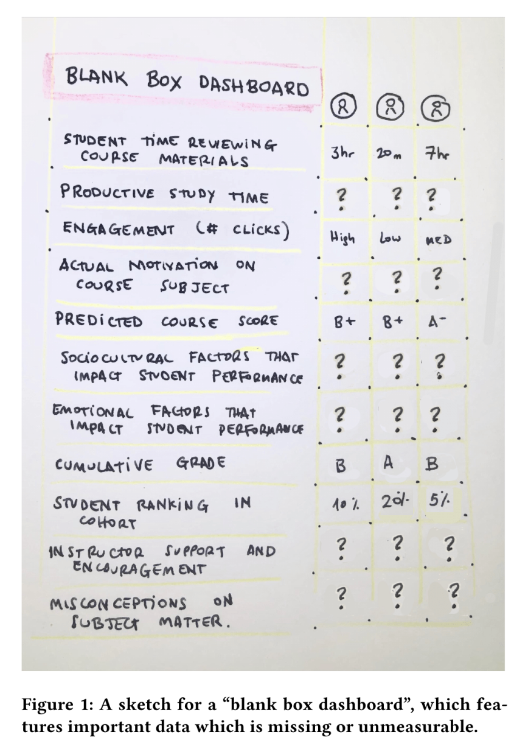
BLANK BOX DASHBOARD
Other things that might impact motivation/learning:
Part time jobs
Family obligations
Access to tutors
Learning disabilities
Sense of belonging
Roommate situation
Wise, A. F., Sarmiento, J. P., & Boothe Jr, M. (2021, April). Subversive learning analytics. In LAK21: 11th international learning analytics and knowledge conference (pp. 639-645).

Slide 182
Sort:
Quiz Average
Quiz 7
Quiz 6
Spotlight:
Students with failing average
Failing Quiz Grades
Quiz 6 Below Average
Show More Data:
Hours studied
Library worker time
Football team practice
Unavailable Data:
Hours studied offline
Calculus misconceptions
Participation in clubs
Off-campus job hours
Family obligations
Previous chemistry training
Learning Disabilities
Sense of belonging on campus
Imposter syndrome scores
Other mental health issues
Professor Q’s Organic Chemistry
Big State University
March 1, 2024
Class Quiz Averages
Laura
Freddy
Rajit
June
Jerry

Slide 183
To summarize
There’s a lot more to data visualization than making pretty charts
Data vis in learning analytics is still a very new area of research
The effects of these visualizations should all be studied
It’s clear that just telling struggling students that their performance is low is not going to help, so we need to make sure that we have helpful data before we do much more than exploration.
I’m looking forward to seeing all of you help to revolutionize the field!

